Slide 1
Class Insecta
Part I

Slide 2
hemimetabolous insects

Slide 3
Order Odonata dragonflies and damselflies

Slide 4
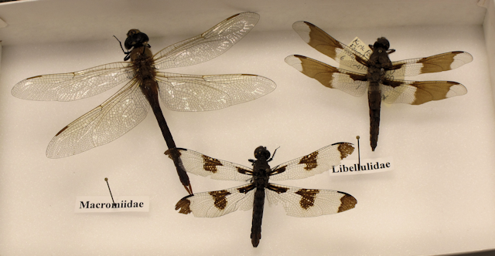

Slide 5
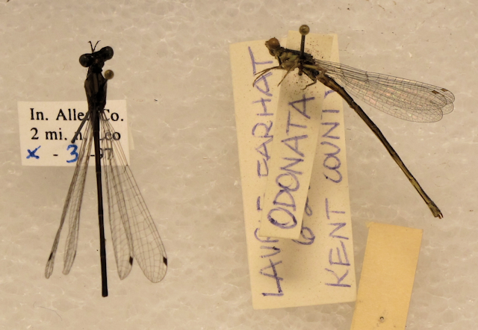

Slide 6
Order Orthoptera grasshoppers, crickets, katydids, walking sticks, cockroaches

Slide 7
short-horned grasshoppers green katydids

Slide 8
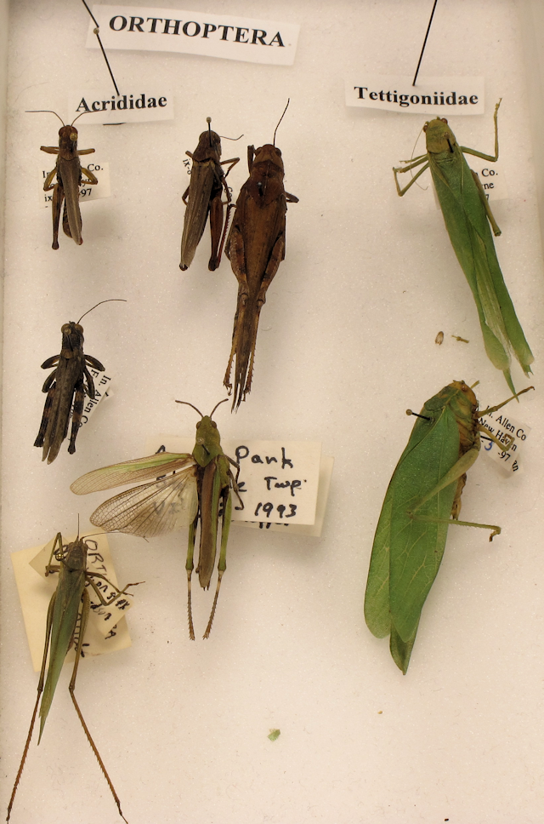

Slide 9
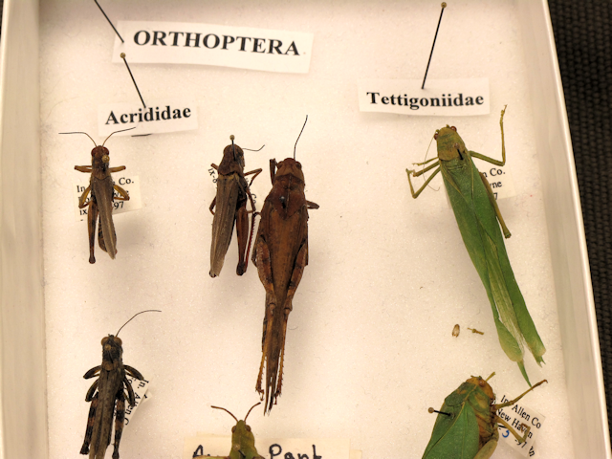

Slide 10
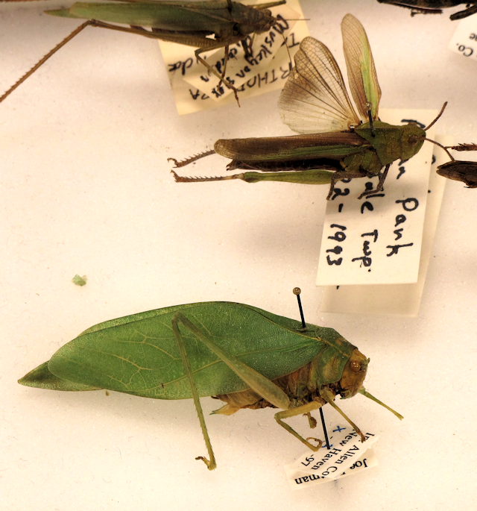

Slide 11
crickets

Slide 12
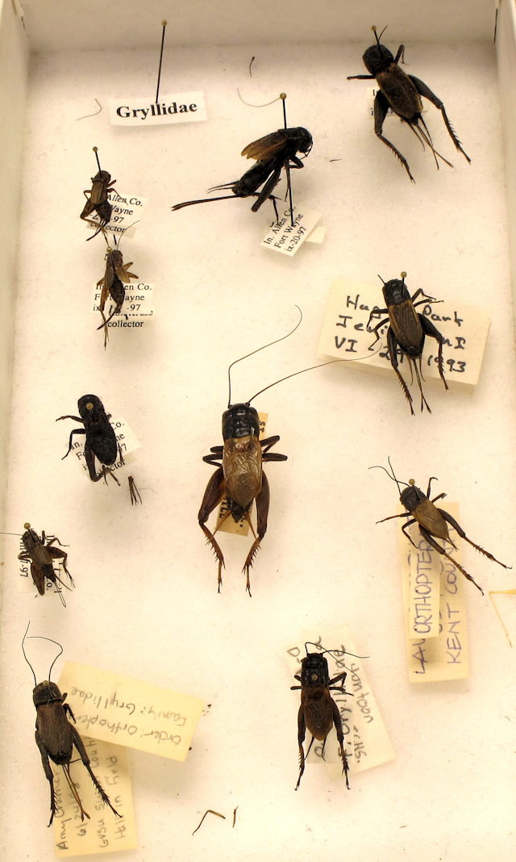

Slide 13
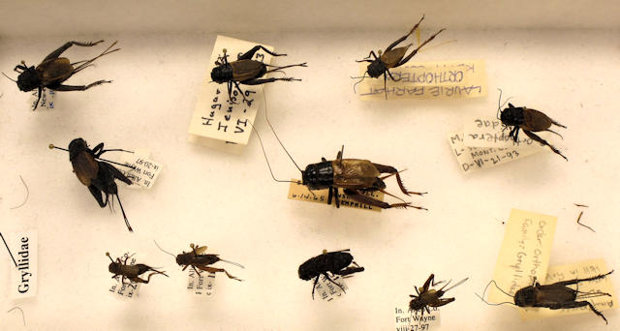

Slide 14
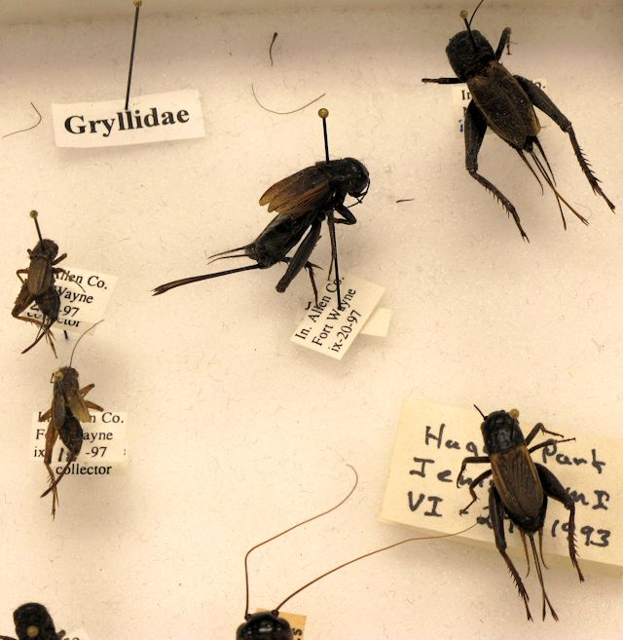

Slide 15
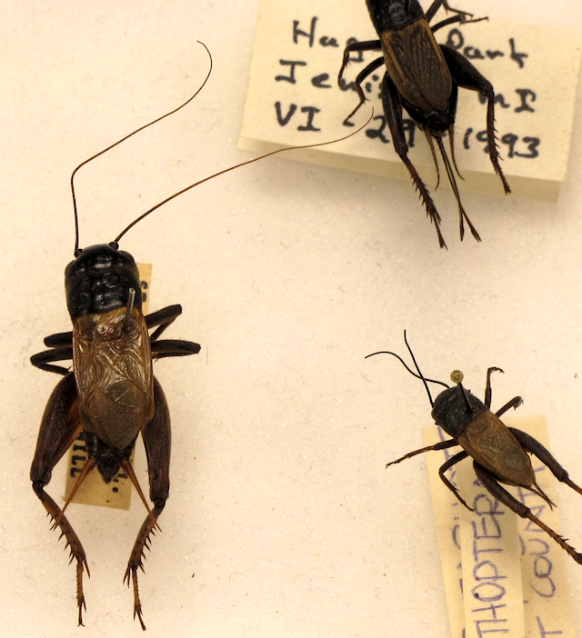

Slide 16
tree crickets

Slide 17
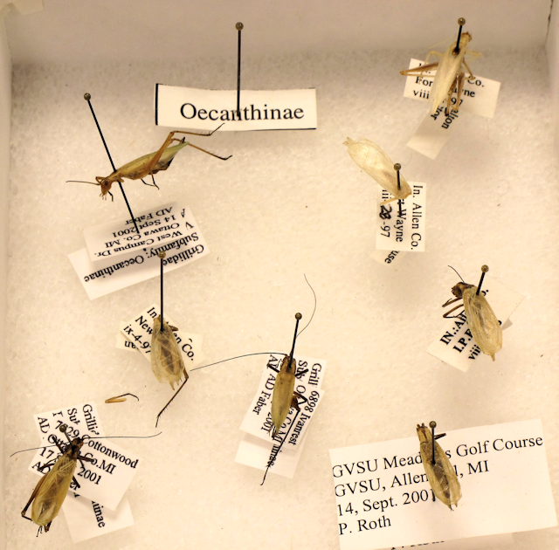

Slide 18
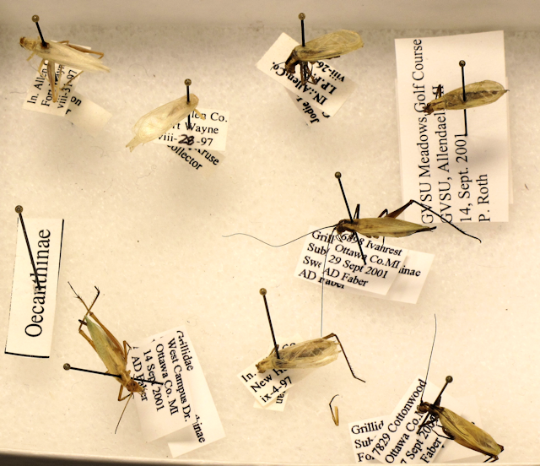

Slide 19
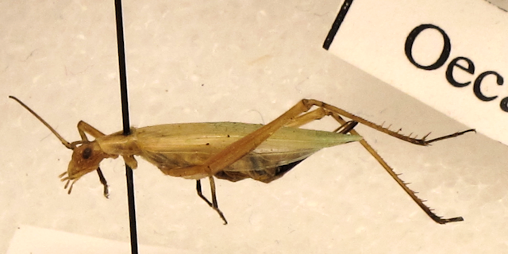

Slide 20
walking sticks

Slide 21
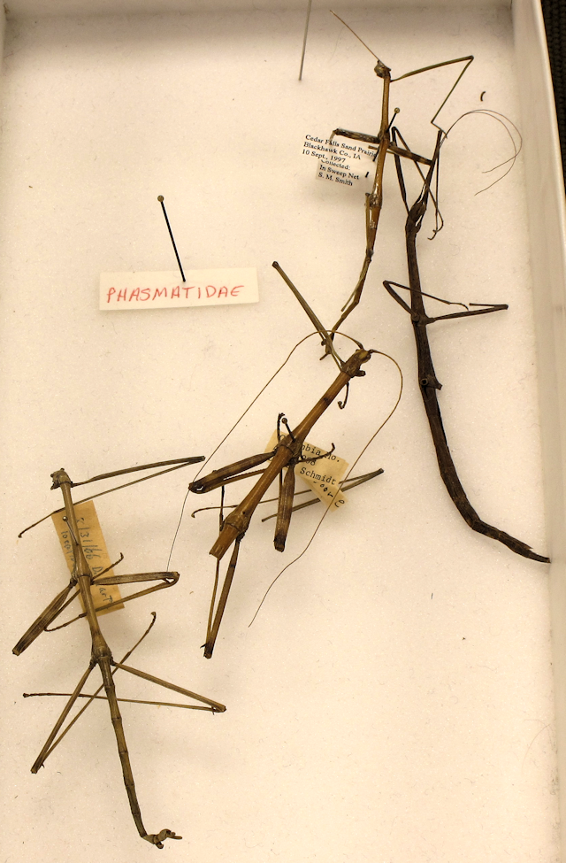

Slide 22
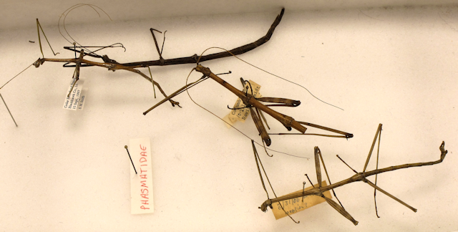

Slide 23
cockroaches

Slide 24
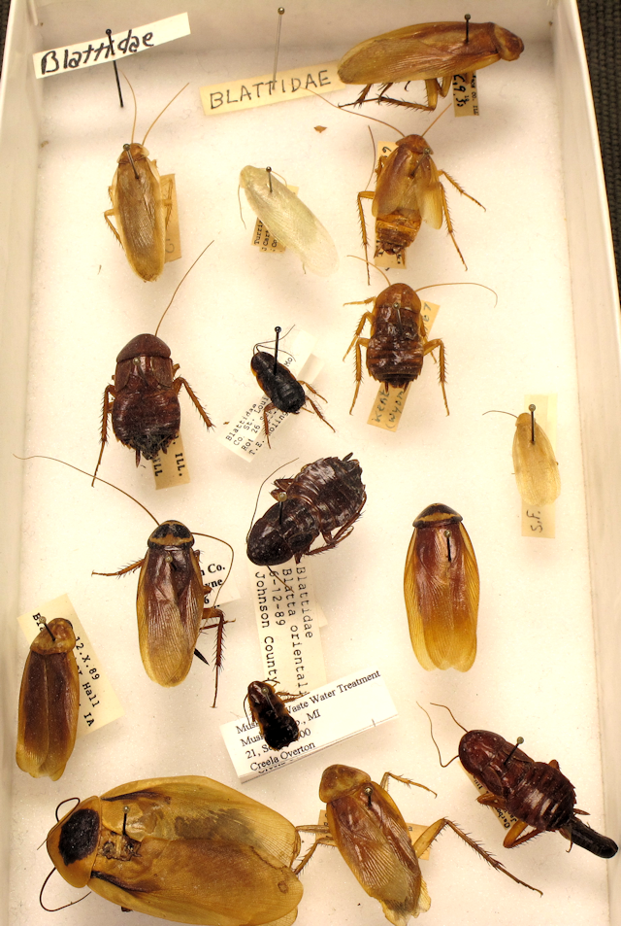

Slide 25
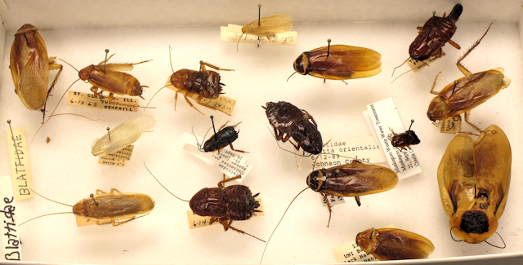

Slide 26
Order Homoptera cicadas, treehoppers

Slide 27
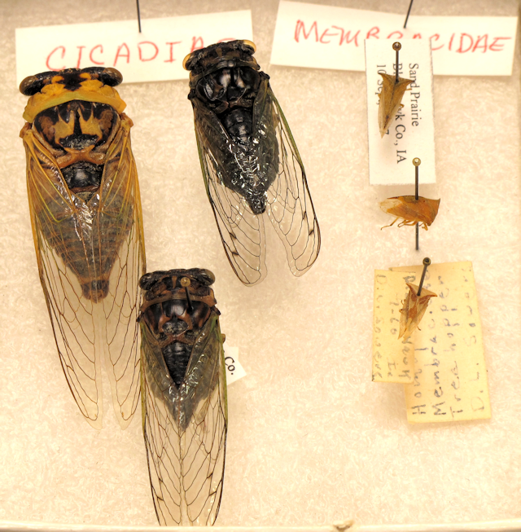

Slide 28
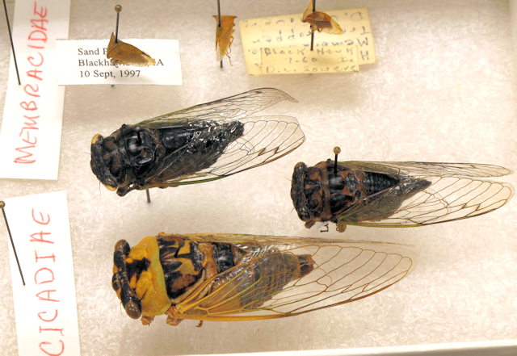

Slide 29
treehoppers

Slide 30
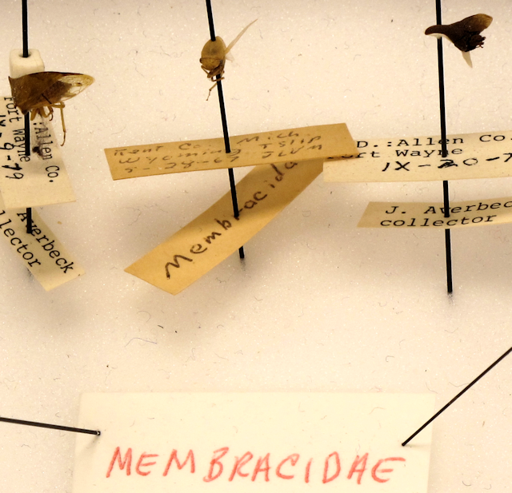

Slide 31
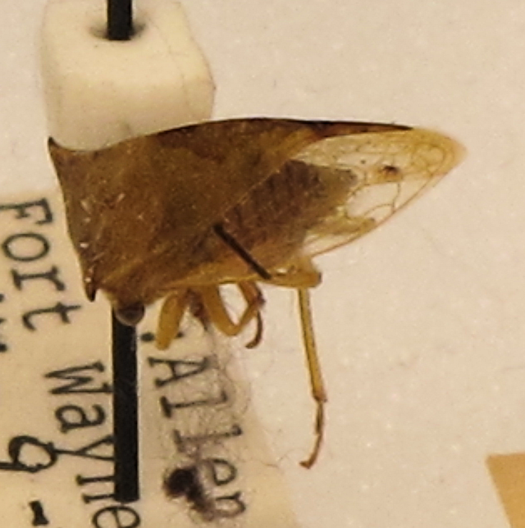

Slide 32
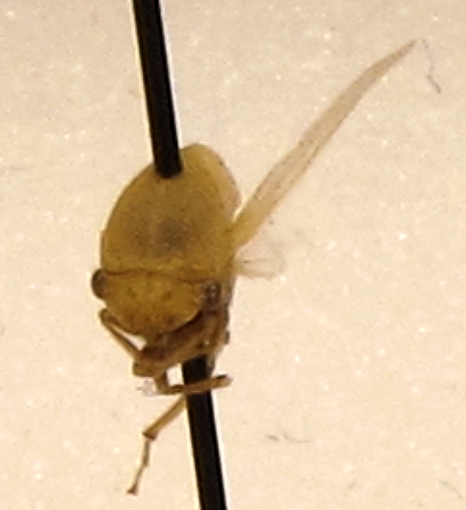

Slide 33
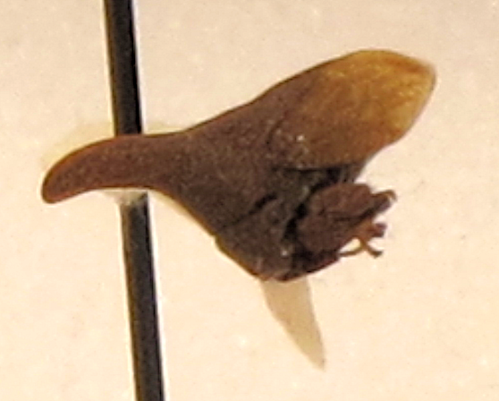

Slide 34
Order Hemiptera true bugs

Slide 35
giant water bugs
(toe biters)

Slide 36
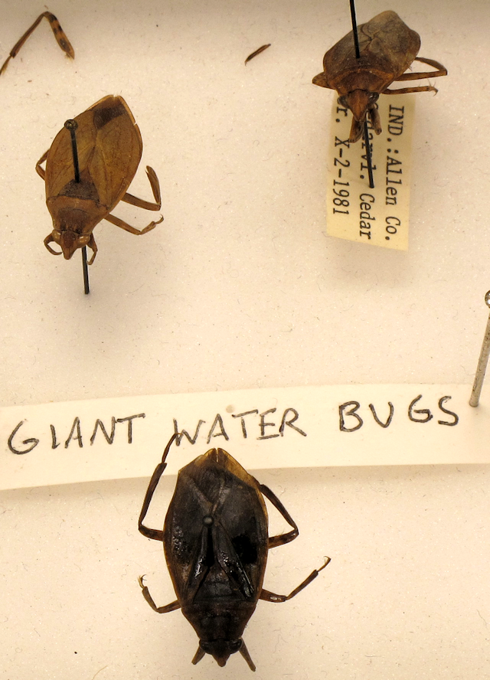

Slide 37
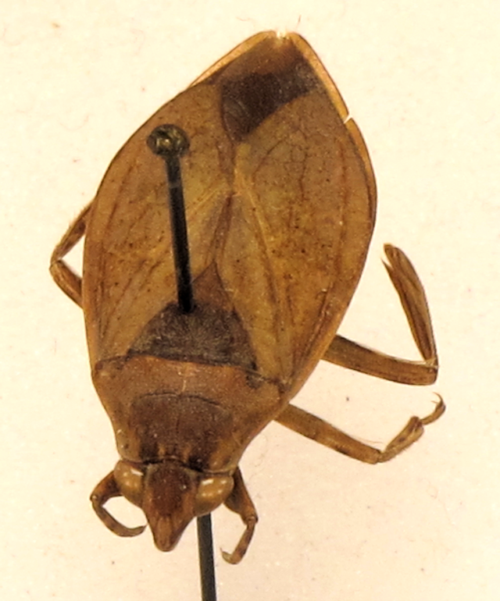

Slide 38
giant water bug and water striders

Slide 39
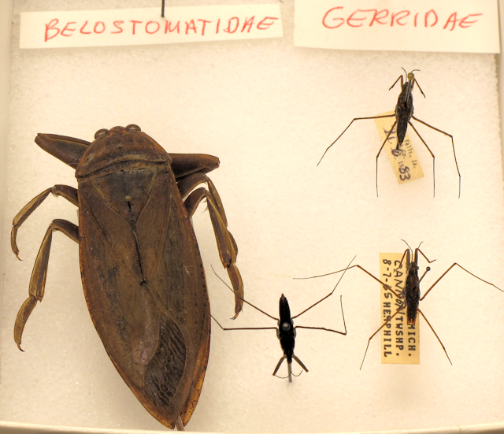

Slide 40
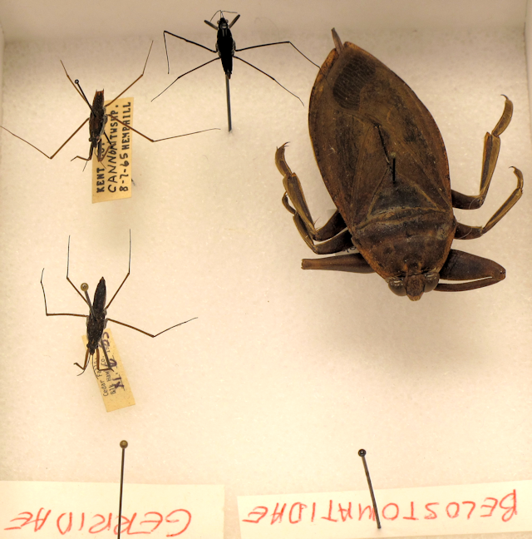

Slide 41
water striders

Slide 42
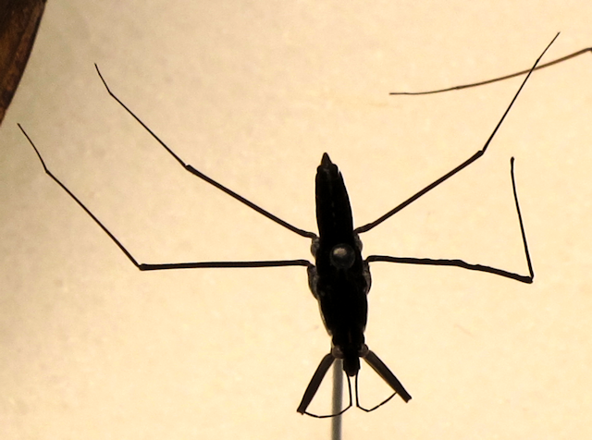

Slide 43
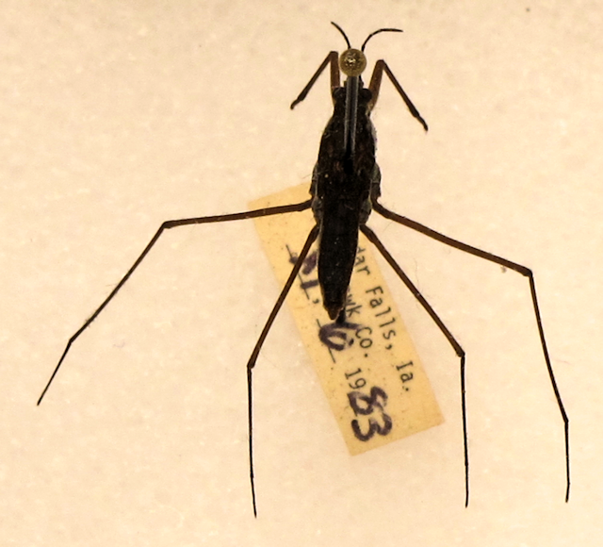

Slide 44
stink bugs

Slide 45
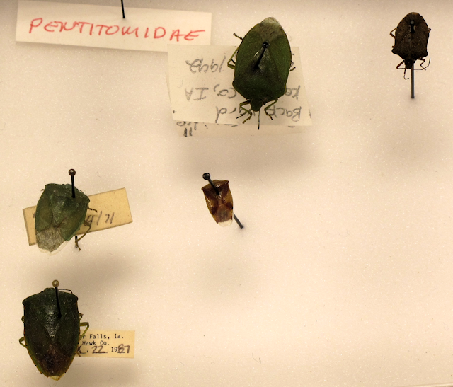

Slide 46
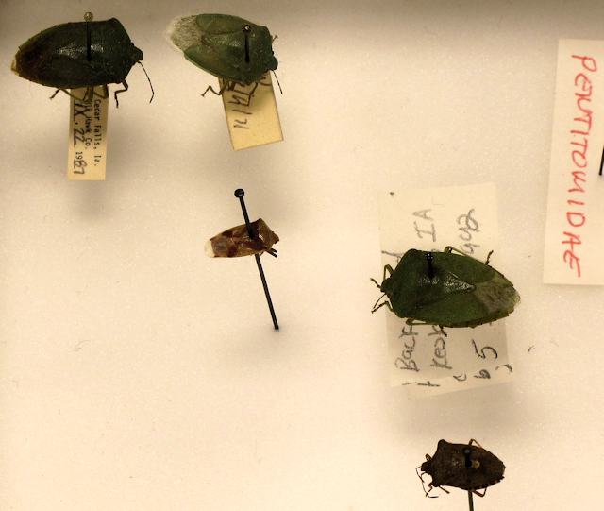

Slide 47
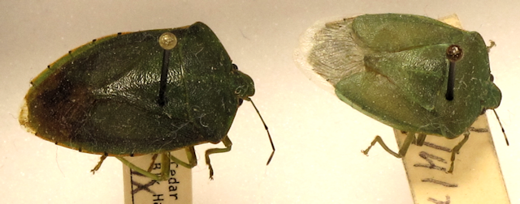

Slide 48
water scorpions

Slide 49
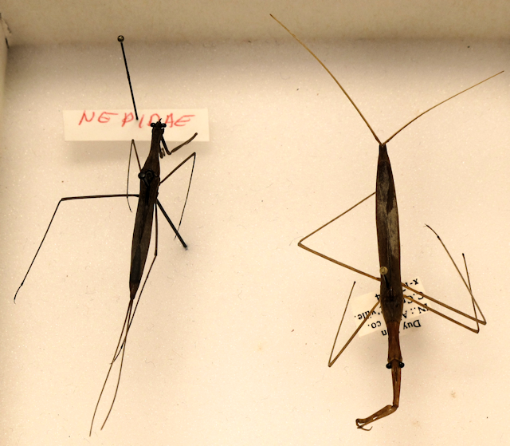

Slide 50
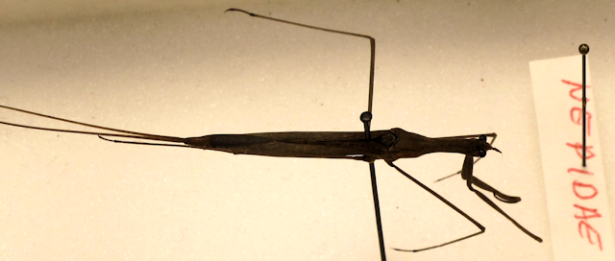

Slide 51
Order Anoplura sucking lice
Pediculus humanus

Slide 52
